Slide 1
Big Data
& Behavioral Targeting:
Changing the Travel Industry Marketing Landscape
Athena Romanelli | Regional Director, Tourism | athena.romanelli@sojern.com

Slide 2
Fun Facts
1902- AAA was the newest technology for drive market tourism
1989- The internet went pubic and travelers had access to billions of resources and the ability to become their own researcher and planner for their vacation
1994-Companies like Amazon started to leverage data to unerstand their cutomers better and continue to offer relevant content and recommendations to enhance their personal experience
2004 Facebook launched and now offers behavioral targeting
Today, a revolutionary technology “Big Data and Behavioral Targeting” has changed the landscape of the Travel Industry
+
+
+
+
+
Notes:
Please reformat and make it look pretty ☺

Slide 3


People Not Proxies – 1:1 Marketing
Profile 01
Profile 02
35 – 45 yrs old
HHI $100k
Child: English Bulldog
Vacation: Palm Springs, Indian Wells
35 – 45 yrs old
HHI $100k
Child: Schnoodle
Vacation: Nashville
Notes:
Profile 1 -Athena tennis and the English Bull dog Profile 2- Athena’s Friend on bike with black dog in sun glasses

Slide 4

Traveler Audience Insights
Sojern’s robust traveler engagement platform is powered by billions of intent data points, machine learning technology, and enhanced programmatic buying, driving insights for partners that are unavailable anywhere else.
Billions of Data Points
Sojern Traveler Platform
Actionable Insights
Travel purchase patterns
Top destinations
Dates of travel
Avg trip length
Travel frequency
Avg # travel activities
% audience overlap with other data sources
Much more!
Notes:
Add Skiing picture to “billions of data points”

Slide 6
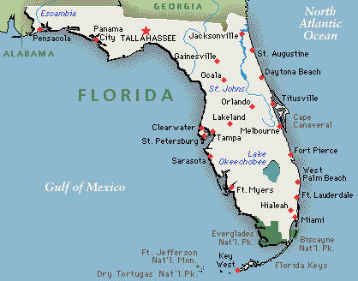



Identify Drive Market Visitors
How We Do It
Sojern reaches and engages travelers in the drive market using our unique first and third party data sets
Sojern identifies Orlando resident searching for Sarasota hotel and layers in type of traveler (business/leisure), single/family, preferences, and purchasing behavior
Sojern then serves relevant, destination-specific ads from Sarasota or neighboring cities
Orlando
Sarasota
Miami
Notes:
Change Drive Market Map to reflect a photo of Vermont with top markets (New York, New Jersey, Boston, Connecticut, Alberta, Montreal and Toronto circled. Please take out all font and enlarge the map

Slide 7
Heads & Beds, Increase length of Stay
Notes:
Find hotel picture and car rental partner logos

Slide 8
Carpe Skiem
Notes:
Please include pictures of skiing, lake, ballet, and biking if you can find one

Slide 9
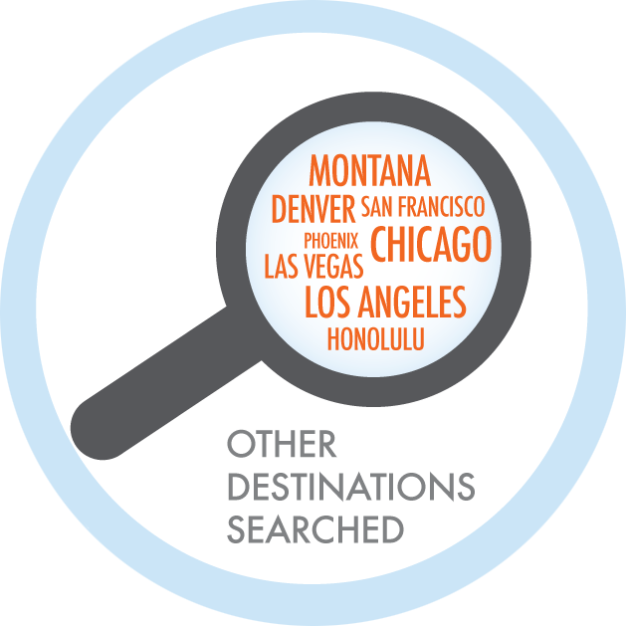
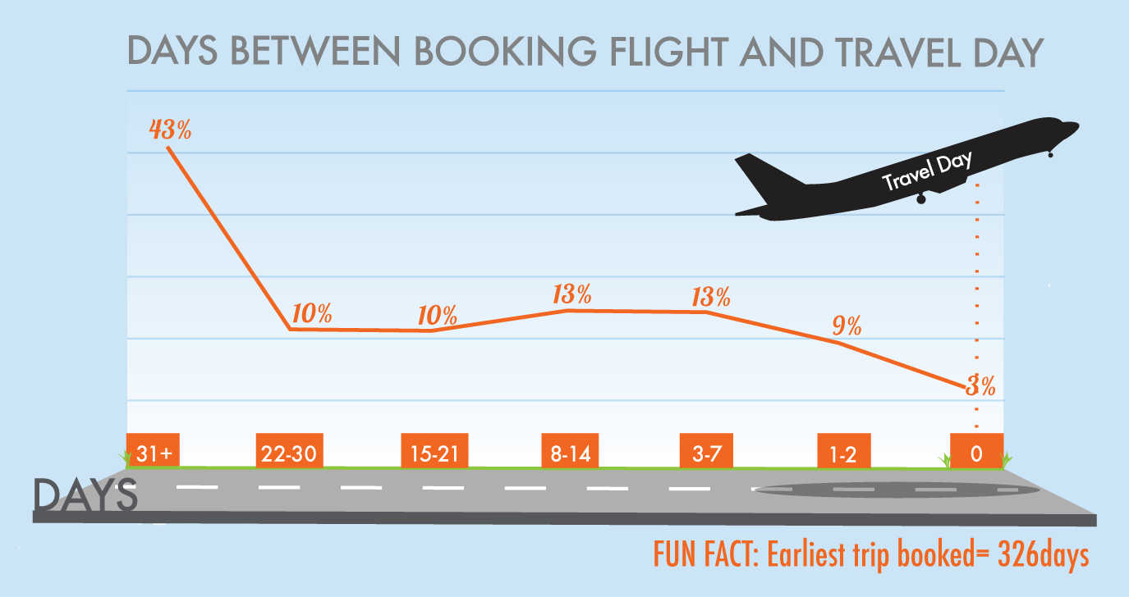
Listen To The Data- Emerging Markets
Consumer habits and intent can be used to define direction and influence future behavior.
Cast a targeted net and find the right consumers.
Notes:
Change cities in magnifying glass to include Denver, Manchester NH, Montreal, Chicago

Slide 10
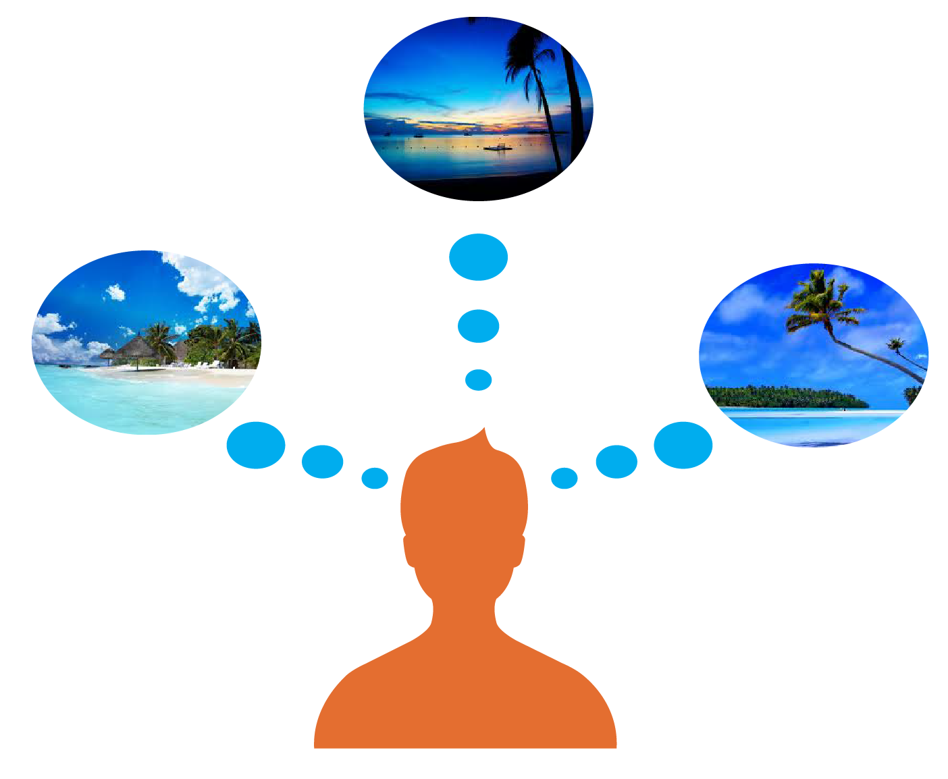


Target Competitive Markets
+
Identify and optimize to your competitive markets, reaching and inspiring travelers who have already expressed intent with your destination
Florida
Hawaii
Costa Rica
Traveler considers a tropical beach vacation
Traveler searches for Sojern client’s competitive destinations
Sojern’s powerful platform identifies traveler searching competitive destinations, and serves our client’s ad
Notes:
Change markets in magnifying glass to Utah, Colorado, Idaho, Montana and deliver “vermont Ad creative”

Slide 11
Common Metrics
Mature Metrics
Clicks
Visits
Page Views
Engagement
Followers/Likes
Number of Destination Visitors
Economic Impact
Conversation Rate
Abandonment Rate
Share of Global Wallet
Task Completion Rate
Notes:
Metrics That Matter

Slide 12
The Promise of Big Data and Behavioral Targeting
The future is in 1:1 marketing
Listen to data and let it guide your marketing decisions
Customize messaging based on consumer actions and travel shopping patterns
Big Data drives value in every step of the travel marketing process
Track what matters
+
+
+
+
+

Slide 13
Thank You!
Athena Romanelli| Regional Director of Tourism | athena.romanelli@sojern.com

